Slide 1
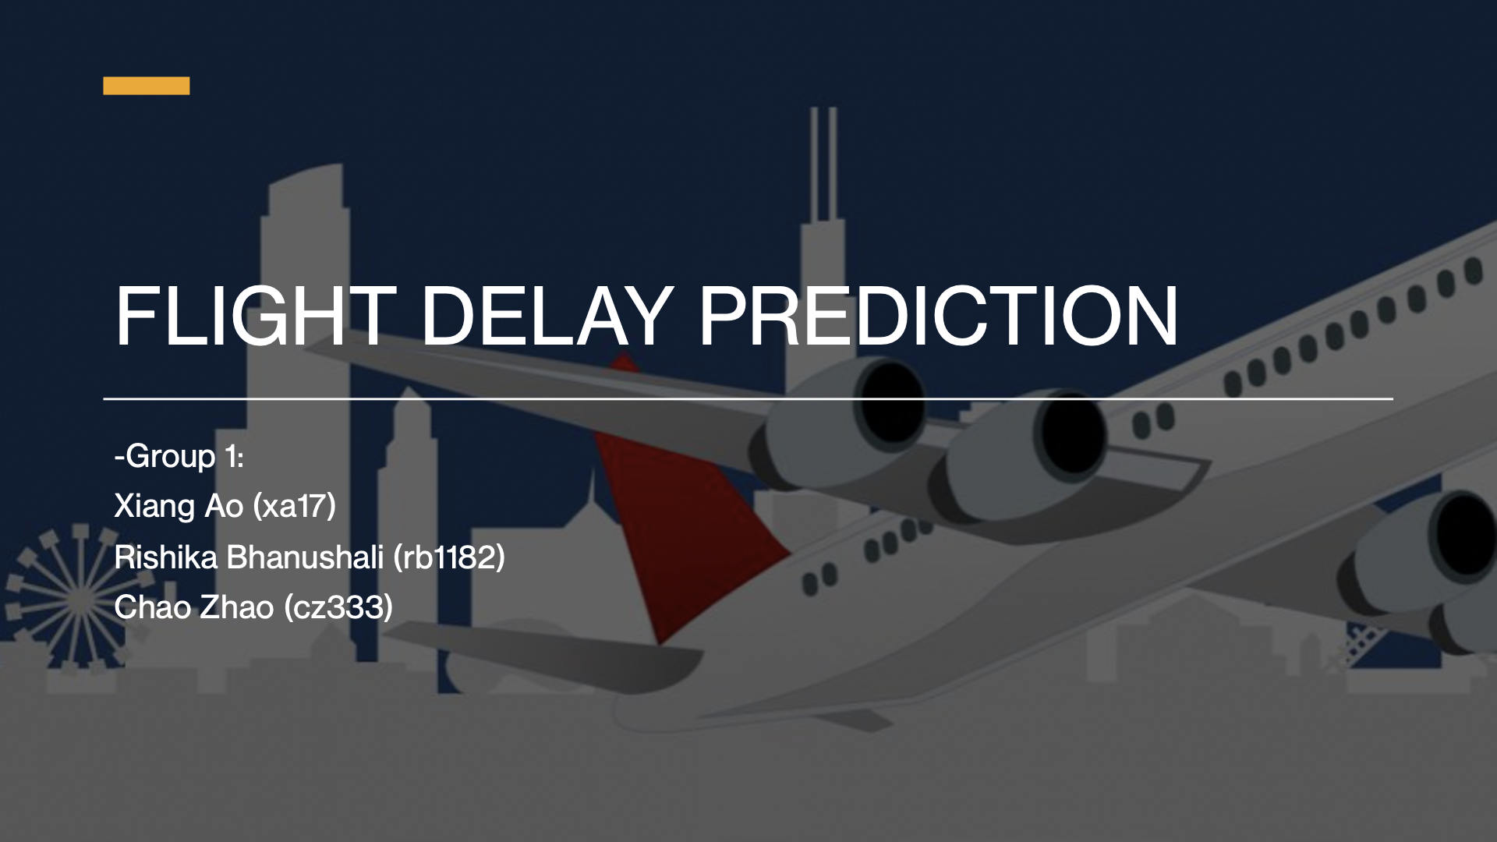

Slide 2
Introduction & Motivation
Target Users
Passengers travelling often for business/leisure
Flight delay is prime factor for economic loss of airlines
Damages Airline’s reputation, causes anxiety among passengers
This project predicting the flight delay using several classification, regression and neural network models.

Slide 3
Table of Contents
Introduction & Motivation
Problem Definition
Tool Used
Dataset Summary
Dataset Preprocessing
Raw Dataset Snippets
Continuous vs. Categorical?
Categorization and Extraction
Conceptual Flowchart and ER Diagram
Processed Data and Snippets
Decision Tree Approach
Introduction
Output & Analysis
Other Regression Approach
Introduction
Output & Analysis
Comparison with Decision Tree
References

Slide 4
Problem Definition
Delay Prediction using Decision Trees, Artificial Neural Network, other Regression techniques and a comparative study between them.
Which airport most likely having delays? Which carrier most likely having delays?
According to our model, what reason caused the delay most?

Slide 5
Data Summary - Raw Data
Airline Delay and Cancellation Data, 2009-2018
Number of records: 61,556,964 rows
Size of each data point: 120 Bytes
Dataset size: 7,446,240 KB (7.4 GB)
Global Historical Climatology Network, 2009-2018 (After dropped irrelevant data)
Number of records: 374,901,608 rows
Size of each data point: 34 Bytes
Dataset size: 13,100,080 KB (13.1 GB)
GHCN Stations
Number of records: 123,182 rows
Size of each data point: 53 Bytes
Dataset size: 6,580 KB (6.5 MB)
Airports in United States of Americas
Number of records: 29,524 rows
Size of each data point: 59 Bytes
Dataset size: 1,764 KB (1.7 MB)

Slide 6
Data Preprocessing - Snippets
Airline Delay and Cancellation Data, 2009-2018:
OP_CARRIER: Flight Carrier’s Brand Abbr.
ORIGIN & DEST: Airport IATA code
CRS_DEP_TIME: Scheduled Departure Time (HHMM), DEP_TIME: Actual Depart Time (HHMM)
DEP_DELAY & ARR_DELAY = Delay Time Elapsed (Minutes)
FL_DATE | OP_CARRIER | ORIGIN | DEST | CRS_DEP_TIME | DEP_TIME | DEP_DELAY | ARR_DELAY | …
1/2/2009 | NW | DTW | PBI | 2110 | 2111 | 1 | -17
1/2/2009 | OO | LAX | SLC | 2116 | 2148 | 32 | 22
1/2/2009 | UA | IAD | TPA | 2140 | 2135 | -5 | -20
1/2/2009 | YV | ORD | ATL | 2109 | 2113 | 4 | 0
1/3/2009 | OO | LAX | SLC | 2116 | 2113 | -3 | -12
1/3/2009 | NW | DTW | PBI | 2110 | 2110 | 0 | -12
1/3/2009 | B6 | JFK | ROC | 2235 | 2251 | 16 | 32
1/3/2009 | B6 | SJU | JFK | 2100 | 2125 | 25 | 35

Slide 7
Data Preprocessing - Snippets
Global Historical Climatology Network Data (Daily), 2009-2018:
TMAX: Maximum temperature (Fahrenheit to tenths), TMIN: Minimum temperature (Fahrenheit to tenths)
PRCP: Precipitation (inches to hundredths), SNOW = Snowfall (inches to hundredths), SNWD = Snow depth (inches to hundredths)
WDF2 = Direction of fastest 2-minute wind (degrees), WSF5 = Fastest 5-second wind speed (miles per hour)
Source: 0 - U.S. Cooperative Summary of the Day, x - U.S. First-Order Summary of the Day
Station ID | Date | Flag | Value | Measurement | Quality | Source | Time
AQW00061705 | 20100101 | TMAX | 317 |  |  | 0 | 700
AQW00061705 | 20100101 | TMIN | 261 |  |  | 0 | 700
AQW00061705 | 20100101 | PRCP | 109 |  |  | 0 | 700
AQW00061705 | 20100101 | SNOW | 0 |  |  | 0
AQW00061705 | 20100101 | SNWD | 0 |  |  | 0
AQW00061705 | 20100101 | WDF2 | 90 |  |  | X
AQW00061705 | 20100101 | WSF2 | 103 |  |  | X

Slide 8
Data Preprocessing
Continuous vs. Categorical?
Our major dataset has various variable types. FLIGHT DATE, CARRIER, ORIGIN, and DEST are discrete variables, while others such as DEPART_TIME, ARRIVE_TIME are continuous.
Conceptually, decision tree can handle both continuous and categorical variables at the same time. However, when making decision, we prefer categorical attributes intuitively, so we need to apply thresholds for each continuous variable for when training the decision tree.
We choose predefined categories for features.
Pros:
It make the training process more intuitive and easier to track.
Avoid high cardinality features.
Cons:
Too few samples in some leaf nodes while arbitrarily define the categories.

Slide 9
Data Preprocessing - Categorize and Extract
Origin and Destination Airports: Although airport IATA codes are discrete variable already, there are 386 different airports in the dataset. Considering most airports may have very few samples, we decided to categorize them into 8 great areas according to the geographical location in national-wise.
Origin and Destination Flight Schedule: We believe that a flight is more likely to be delayed, if the schedule of this flight is in the busiest time at an airport. So we divided schedule into Most Busy, Busy, and Least Busy.
Origin and Destination Weather Conditions: It is well known that weather is the main factor for flights delay[1], but the data provided by the weather website is too detailed. The samples will be too few too. Therefore, those weather flags were selected and classified into 4 main weather conditions: sunny, windy, rainy and snowy.
Carriers: There are only 23 distinct carriers in the dataset. In order to keeping the model simpler, we use 3 types of carrier to classify them, which is Normal, Low Cost, and Ultra Low Cost.
Departure Delays and Arrival Delays: We mainly focusing on arrival delays. According to the dataset, arrival delays are the differences between schedule arrival and actual arrival. Again, for the sake of simpleness, we predefined time elapsed ranges into 9 categories.

Slide 10
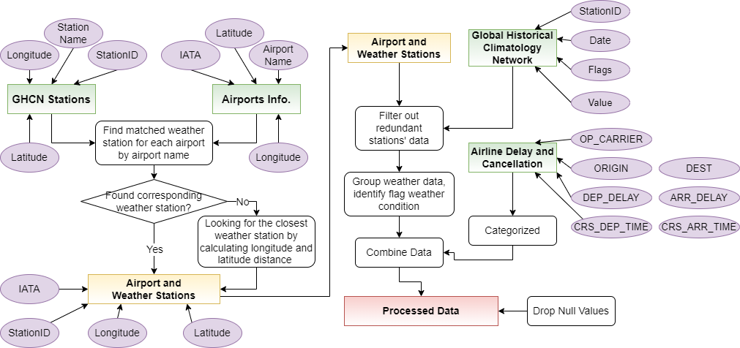
Data Preprocessing - Conceptual Flowchart

Slide 11
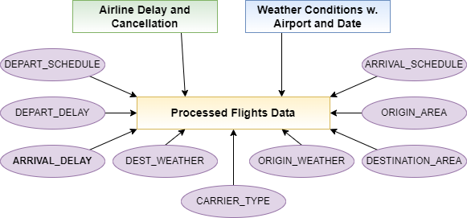
Data Preprocessing - ER Diagram

Slide 12
Data Summary - Processed Data
Number of features: 8
Number of records: 54,246,033 rows
Size of each data point: 66 Bytes
Dataset size: 3,585,600 KB (3.5 GB)
Rows processed per second: 56,500 rows
ORIG_AREA & DEST_AREA:
NorthEast, SouthEast, NorthWest, SouthWest, Center-NorthEast, Center-SouthEast, Center-NorthWest, Center-SouthWest
ORIG_SCHEDULE & DEST_SCHEDULE:
Most Busy (8AM-5PM), Busy (6PM-5AM), Least Busy (6AM-7AM)
CARRIER_TYPE:
Normal, Low Cost, Ultra Low Cost
DEP_DELAY_CAT & ARR_DELAY_CAT:
60 min+ early, 30 to 60 min early, 15 to 30 min early, 5 to 15 min early, On Time, 5 to 15 min late, 15 to 30 min late, 30 to 60 min late, 60 min+ late
ORIG_WEAHTER & DEST_WEATHER:
Sunny, Rainy, Snowy, Windy

Slide 13
Data Preprocessing - Snippets
Processed Flight and Weather Data, 2009-2018:
ORIG_AREA | DEST_AREA | ORIG_WEATHER | DEST_WEATHER | ORIG_SCHEDULE | DEST_SCHEDULE | CARRIER_TYPE | DEP_DELAY_CAT | ARR_DELAY_CAT
SW | MSE | Rain | Snow | Most Busy | Busy | Normal | 60+min late | 30~60min late
MSE | MSE | Rain | Snow | Most Busy | Most Busy | Normal | 5~15min early | 5~15min late
MSE | MSW | Rain | Snow | Most Busy | Most Busy | Normal | 5~15min early | 15~30min early
NW | NW | Rain | Snow | Most Busy | Most Busy | Normal | 5~15min late | 15~30min late
MSE | NE | Rain | Snow | Most Busy | Most Busy | Low Cost | 5~15min early | On Time
NE | NE | Rain | Snow | Most Busy | Most Busy | Low Cost | 5~15min early | 15~30min early
SW | NW | Rain | Snow | Most Busy | Busy | Normal | 5~15min early | 15~30min early
SW | MSE | Rain | Rain | Most Busy | Most Busy | Normal | On Time | 15~30min early
MNE | MSE | Rain | Snow | Most Busy | Most Busy | Normal | On Time | 15~30min early

Slide 14

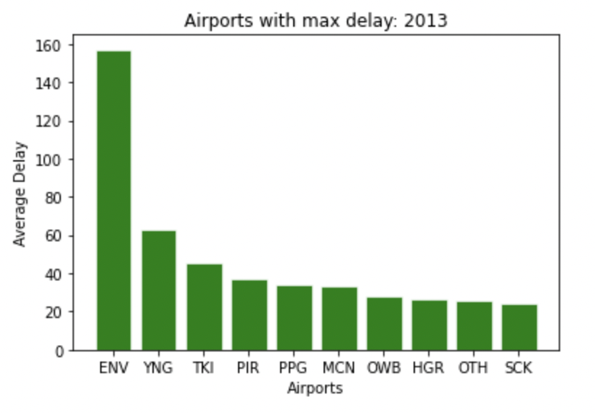
Data Insights
QUESTION- Which Airport has maximum Delays?

Slide 15
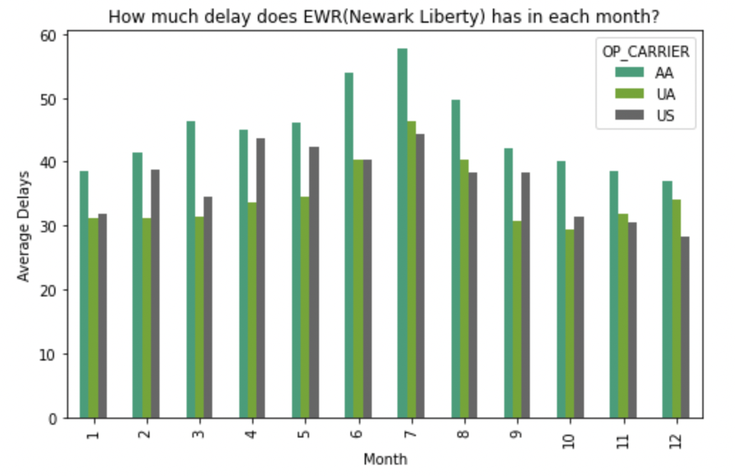
Data Insights
QUESTION- How much delays do the different carriers at EWR Experience?

Slide 16
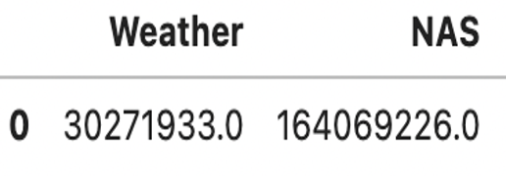
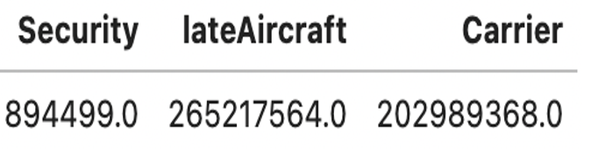
Data Insights
QUESTION- Primary Reason for Delays?

Slide 17
Decision Tree Model
Based on categorical data
For each tree node, find an attribute to split, and modify the dataset
The metric used to find the best split is Entropy
With the max depth to be 5 and entropy threshold to be 1.0, the overall accuracy is 42.13%, details as below:
arr_delay | <-60 | [-59, -30] | [-29, -10] | [-9, -2] | [-1, 2] | [3, 10] | [11, 30] | [31, 60] | >60
TP + FN | 665 | 101945 | 875369 | 1528655 | 1407082 | 545335 | 370960 | 294037 | 300556
TP + FP | 9 | 374 | 646857 | 2686093 | 1161053 | 30216 | 315278 | 286301 | 298423
TP | 5 | 182 | 233746 | 1020333 | 469821 | 10803 | 124852 | 166697 | 258695
Precision | 0.556 | 0.487 | 0.361 | 0.380 | 0.405 | 0.358 | 0.396 | 0.582 | 0.867
recall | 0.008 | 0.002 | 0.267 | 0.667 | 0.334 | 0.020 | 0.337 | 0.567 | 0.861
F1 score | 0.015 | 0.004 | 0.307 | 0.484 | 0.366 | 0.038 | 0.364 | 0.574 | 0.864
Notes:
Thank you Xiang. Hi, everyone, I am Chao, I will talk about our implementation of the decision tree. First, our model is built based on the categorized data, in this case, we could build our tree with entropy. You may wonder why not using continuous data, this is because the implementation with continuous data require using variance to find the best split, while there are a lot more computations compared to the current approach. Considering that we only have limited resources in ilab, so we chose to build our model using categorical data.
Based on our experiments, the overall accuracy is about 42%, and we can see from this table, for some label, we have really good F1 score, while for some labels, the F1 score can be really bad. We think the reason for this is mainly because of the way we categorize the data, since the data is not evenly distributed.

Slide 18
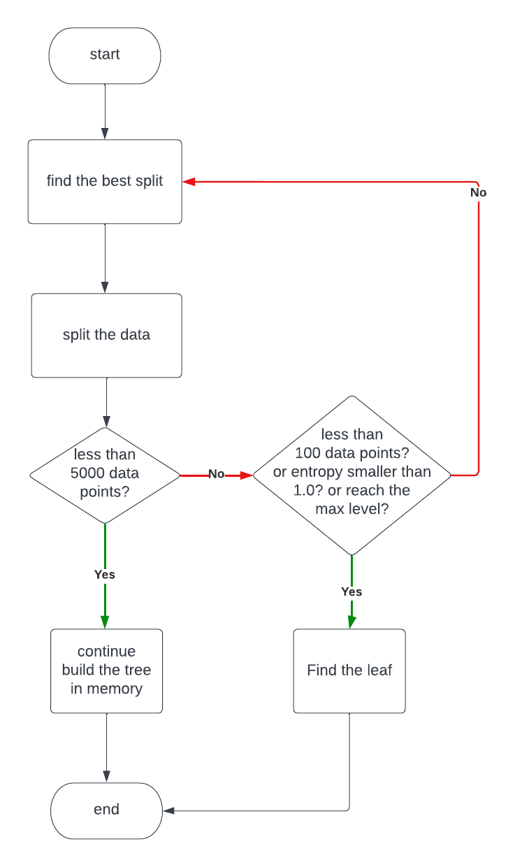
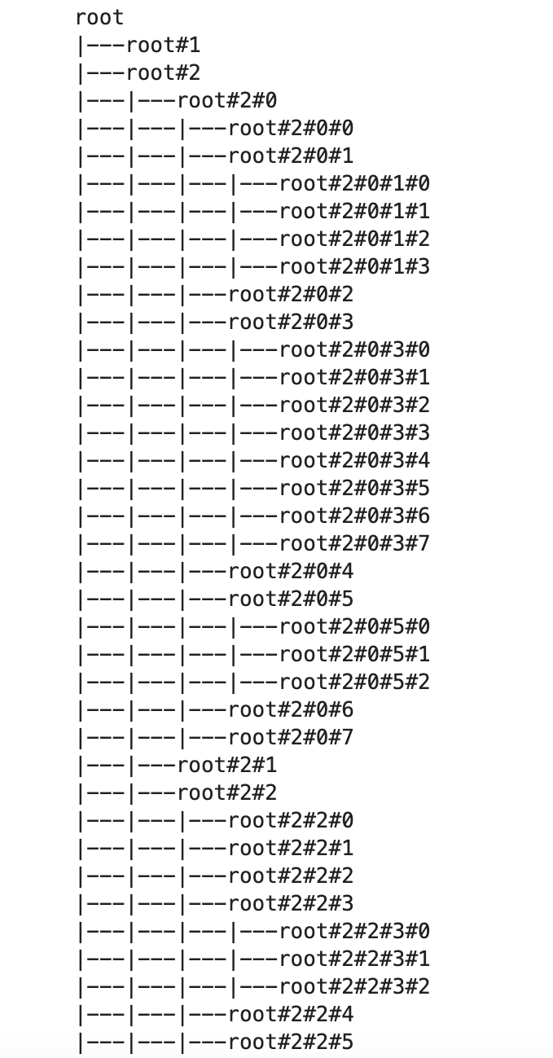
Technical Approach
buildTree using MapReduce
Implement a Breadth First Search to build the Decision Tree.
Leverage MapReduce to compute the Entropy and Information Gain, so as to find the best split.
buildTree in Memory
Implement a Depth First Search to construct the Decision Tree in memory when the data size is small enough after several splits.
Training - When to stop?
Number of data points is small enough
Entropy is small enough
Reach the max level of the tree
The training process takes about 30 min to complete, our model training process about 26 thousands of records per second.
Prediction?
Take the mode of the dataset w.r.t the corresponding leaf node as the prediction.
Notes:
As for the technical approaches, the training process, which is the process of constructing the Decision Tree, can be divided into 2 separate parts, build the tree with Pyspark, and build the tree in memory when the size of the dataset is small enough to fit in to memory.
For the MapReduce part, we basically implement a Breadth First Search process to build the tree, and use PySpark to compute the Information gain so as to find the best split. One thing to mention here is that, if you try to implement what we did here, be careful with the persist operation of RDDs, since the RDD could be collected by the JVM anytime after the first operation to it, We spent a lot of time here debugging this issue.
Each split, the size of the dataset corresponds to a tree node will get smaller, after the size is smaller than 5,000, we will use the in memory build process to continue building the tree from that node. And this process is basically a Depth first Search process.
While, we also need to decide when to stop the training, as if we just leave it and let it run, it will have overfitting issues. So as we have 9 attributes,

Slide 19
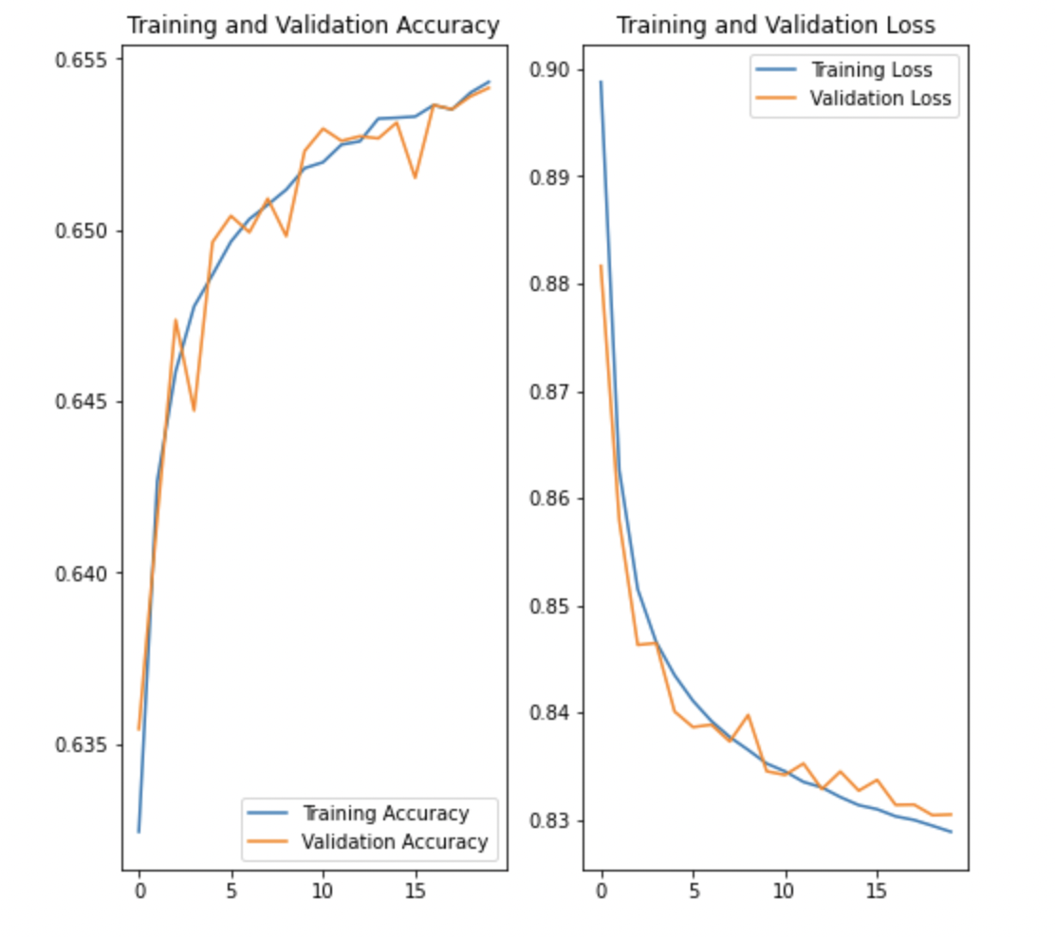
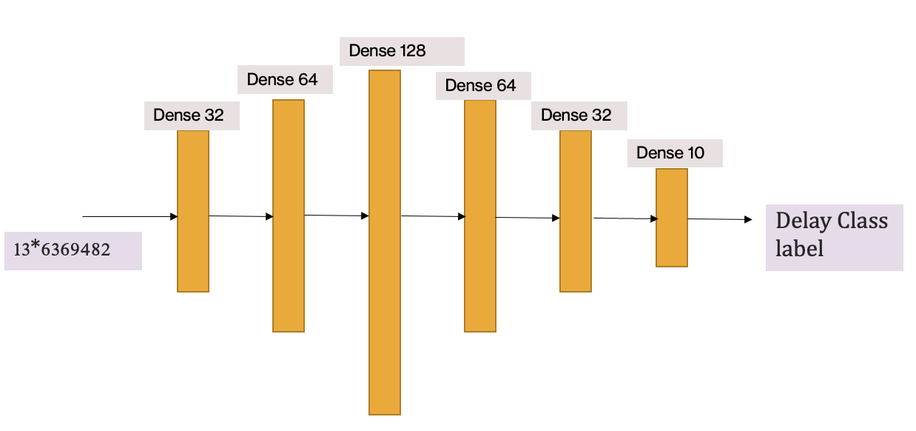
ANN model
Build an ANN with 5 dense hidden layers and one output layer
Results
Optimizer- ADAM, Loss Function- Categorical Cross Entropy
Activation- Softmax
Hyperparameters- Learning Rate, Dropout tweaking
Network Architecture

Slide 20
Experiments
Tried the following:
Regression models (Linear, Boosted Linear, Decision Tree Regressor)
Tried different features and data cleaning techniques
Different architectures of ANN
Removed Outliers!
Model | MAE | MSE | MAE | MSE
AdaBoost | 27.40 | 2146.87 | 11.009 | 242.58
Linear Regression | 6.41 | 88.729 | 6.17 | 71.53
Decision Tree Regressor | 5.006 | 83.16 | 4.816 | 59.623

Slide 21
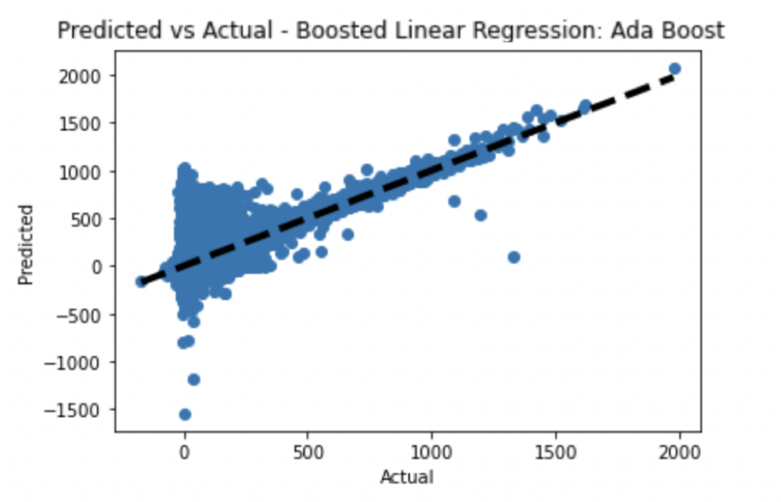
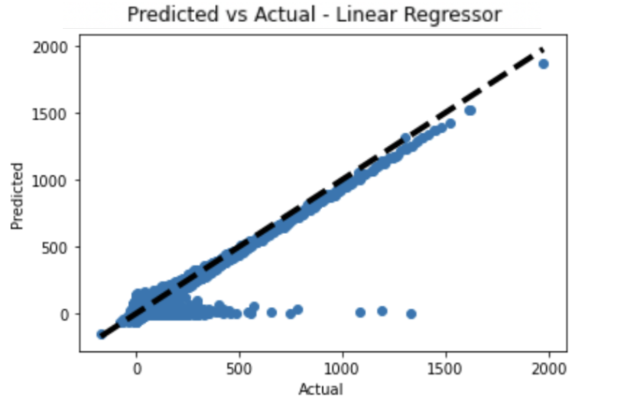
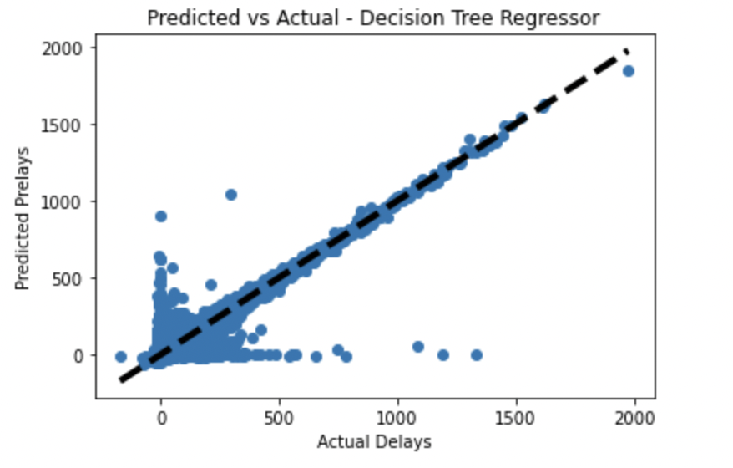
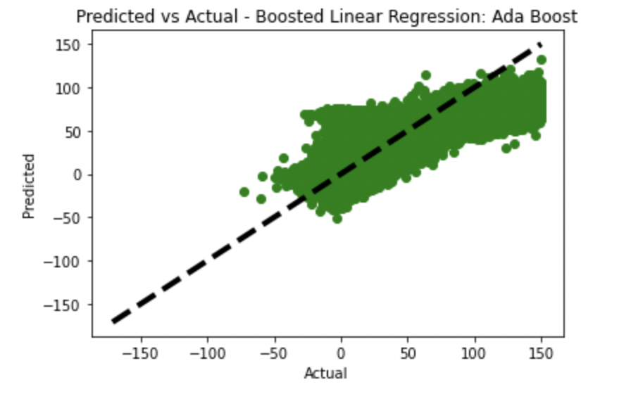
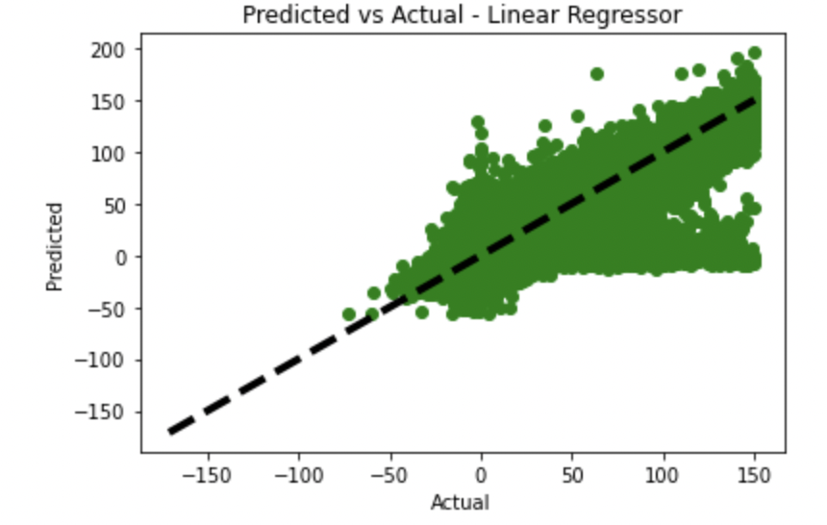
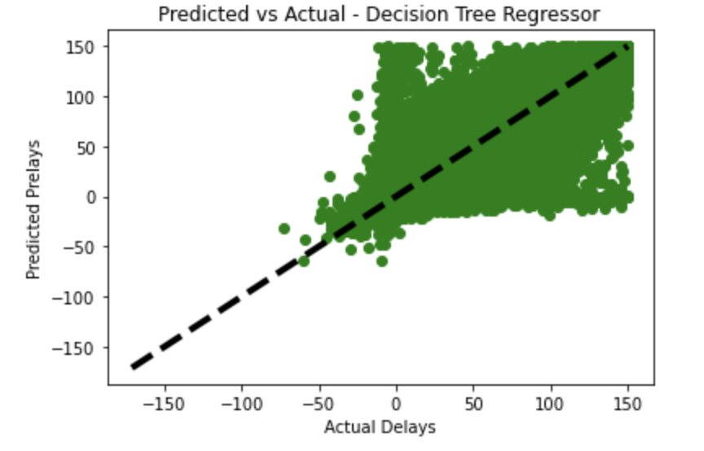
Experiments- Regression

Slide 22

Experiments- ANN

Slide 23

Tools and Technologies used
Rutgers iLab machines
VSCode, Jupyter notebook
Python 3.8
Libraries- Tensorflow, scikit-learn

Slide 24
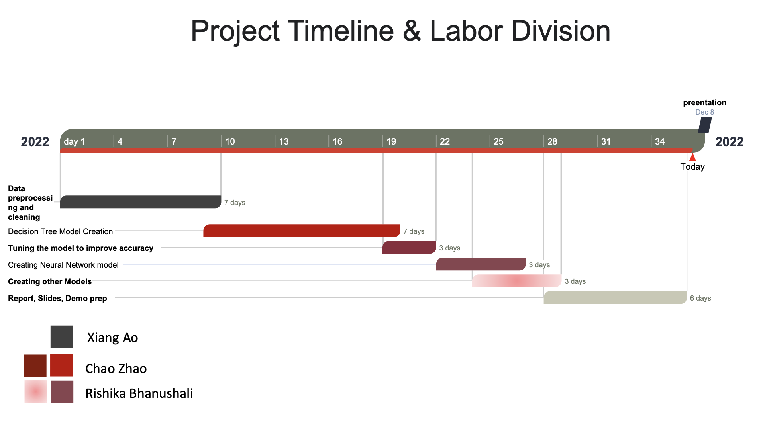

Slide 25
Conclusion
The major reason that causes delays was not weather conditions we thought at first, but actually delays of previous flight causes.
Decision Tree model is a better Regressor model of the three Regression models used.
Continuous Values are better for regression tasks.
The way to process the data has a great impact on the performance of the Decision Tree.
Potential Improvements
Trying to include more features in our data
A better strategy of preprocessing the data could potentially improve the performance of our Decision Tree model.

Slide 26

Questions?

